Slide 1

Transportation analysis of the UK
Philip Wilkinson
Cheyne Campbell
Alicja Kotarba
Nathanael Sheehan
Hussein Mahfouz

Slide 2
Purpose & AIMS
Purpose
Inform policy and the general public of the differences in transport usage to travel to work across England and Wales
Aims
Identify different transport profiles
Map the different transport profiles and flows
Look at how demographic factors are related to these transport profiles

Slide 3
Data
Public transport stops – Department of travel (2014)
Car ownership – 2011 census
Commuter Flow Data – 2011 census
Travel Time Data – Quant Project CASA

Slide 4
Preparation
Cleaning: get data in the correct format and units
Transformation: reduce skewness of the data
Standardisation: Put variables in the same units and scale
Notes:
Clustering is sensitive to the inputs

Slide 5
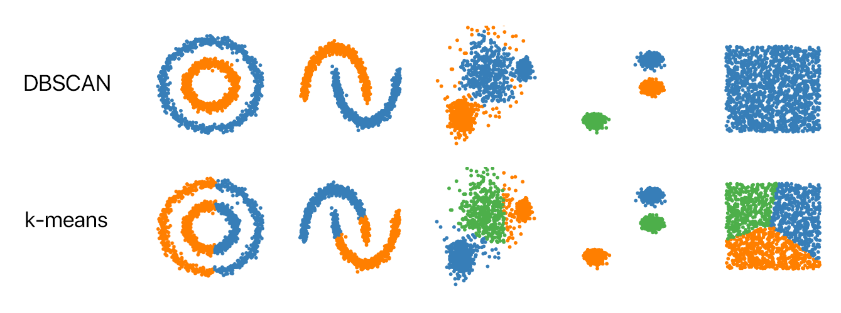
Clustering
Kmeans
Hierarchical (Agglomerative)
DBScan
Picture taken from: https://github.com/NSHipster/DBSCAN
Notes:
Kmeans
Randomly places a specified number of cluster centres within the data
Points close to those centres are attributed to that cluster
The centre of those points are calculated and the cluster point is moved
This process is repeated
Hierarchical (Agglomerative)
A
DBScan
A distance of (ε) is specified, along with a minimum number of points
A cluster is formed when both conditions are met

Slide 6
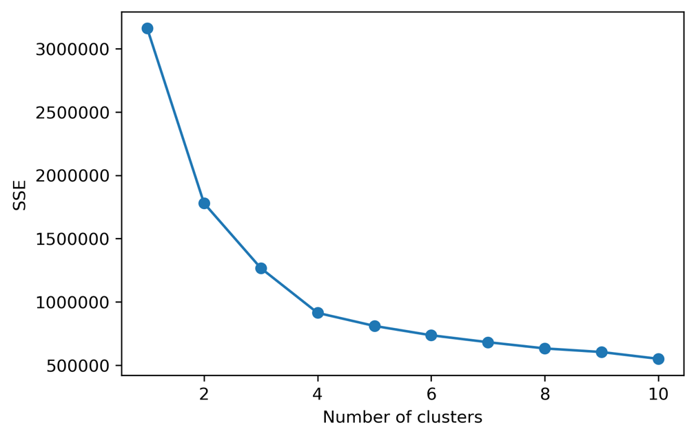
Clustering: Performance measures
Elbow plots
Silhouette scores
Figure X: elbow plot for log-idr-kmeans indicating that 4 clusters should be used
Notes:
Elbow plots
Based on minimising the within-cluser sum of squares
The higher the number of clusters the lower the WSS
Ensure we do not overfit the data by choosing the number where improvement is marginal
Silhouette scores
The closer points in a cluster are to each other and the further away they are from points in other clusters the better the silhouette score

Slide 7
CLUSTERING: CHOSEN WORKFLOW
log transformation
z-score standardization
k-means clustering

Slide 8
CLUSTERING: RESULTS
Profile 1: Good train accessibility but car dependant
Profile 2: Solely car dependant
Profile 3: Lack of accessibility across all Transport mode
Profile 4: High public transport and good accessibility
Profile 5: Car reliant but high public transport

Slide 9
Classification
Data Used
Net annual income (£)
Population Density
Unemployment Rate
Education Level
Household Ownership
Household Size
Health
Age
Religion
Employment
Female Employment
Full-time Employment

Slide 10

Classification
Random forest
100 trees with a max depth of 3 to aid interpretability
Accuracy shows that 65% of MSOAs are correctly classified by the model
Most important features: population per hectare and net annual income (£)
Interpretability could come from exploring the individual trees

Slide 11
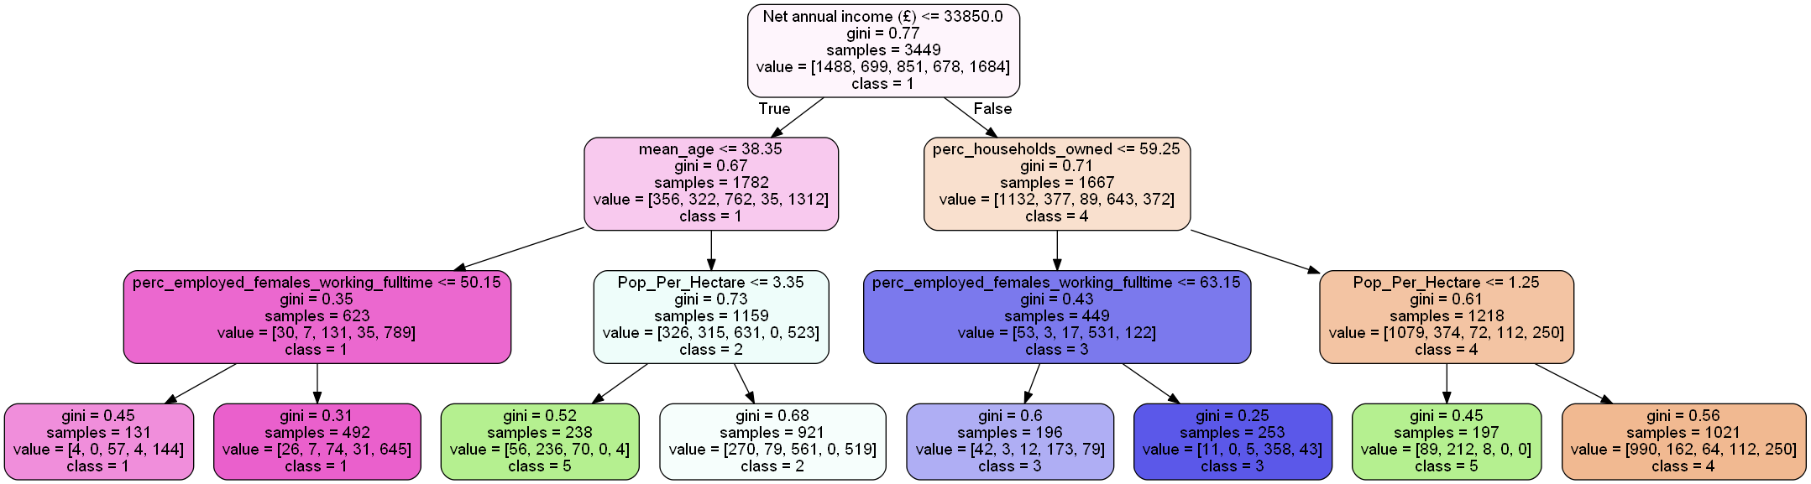
Classification RESULTS

